Slide 1


Solar Radiation Prediction
Prepared By:-
Krupesh Shah
Shivani Vaghasiya
Nilang Patel
Sagar Kokku
Kevin Pansuriya
Guided By:- Kevin Fernandez

Slide 2
Solar Radiation Prediction
Problem Statement
Abstract
Motivation
Methodology
Data Visualization

Slide 3
Problem Statement
Solar energy is becoming increasingly important as a renewable energy source due to its abundant availability and environmental benefits. However, solar energy generation is highly dependent on the amount of solar radiation received at a particular location, which can vary due to changes in weather patterns, cloud cover, and other environmental factors. Accurately predicting the amount of solar radiation that will be received at a particular location is therefore crucial for effective solar energy planning and management.

Slide 4
Abstract
Solar radiation is an important factor in the generation of solar energy, which is becoming increasingly important as a renewable energy source.
Accurately predicting solar radiation levels is crucial for effective solar energy planning and management, and traditional methods rely on physical models that can be computationally intensive and require a lot of data input.
The outcome of this project will be a machine-learning model that can provide accurate predictions and insights into the most effective methods for solar radiation prediction.
This can contribute to the development of more efficient and sustainable renewable energy systems.

Slide 5
Motivation
The sun is a non-depletable source of energy that produces very little to no pollution. However, the quantity of solar energy that can be captured and stored using present technologies to transform solar energy into electricity is very limited.
Our objective is to use widely accessible weather data to create high-confidence forecasts of solar generation (through solar intensity). This will make it possible for fossil fuel-based power generation to be better regulated.
We have obtained meteorological information as well as sun intensity from NSRDB and Sunrise-Sunset-API.

Slide 6
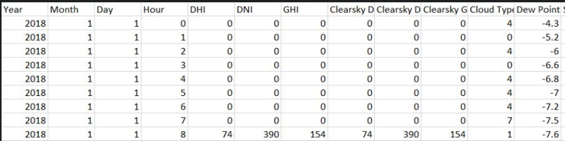
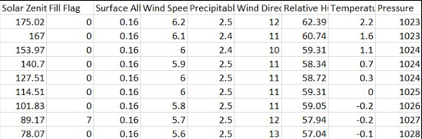
Dataset

Slide 7
KPI
Factor | Unit | Description
TimeStamp | DateTime | Year, month, Day, Hours, Minute
GHI | Watt per square meter | Modeled solar radiation on a horizontal surface received from the sky.
DNI | Watt per square meter | Modeled solar radiation obtained from the direction of the sun.
DHI | Watt per square meter | Modeled solar radiation on a horizontal surface received from the sky excluding the solar disk.
Dew Point | Degree C | Calculated from specific humidity
Solar Zenith Angle | Degrees | Angle between the sun and the zenith
Relative Humidity | Percent | Calculated from specific humidity
Wind Speed | Meter per second | Wind speed
Temperature | Degree C | Temperature
Pressure | Millibar | Pressure
Cloud Type | Unitless | Clear, Fog, Dust, Water, Smoke, Mixed

Slide 8
Technology
Language: Python
Tools: PowerBI, Jupyter Notebook, VS Code, Github, Excel
Library: Pandas, Matplotlib, Numpy, Seaborn, Statsmodels.api, Adfuller, Autocorrelation_plot, plot_acf, plot_pacf, Prophet

Slide 9
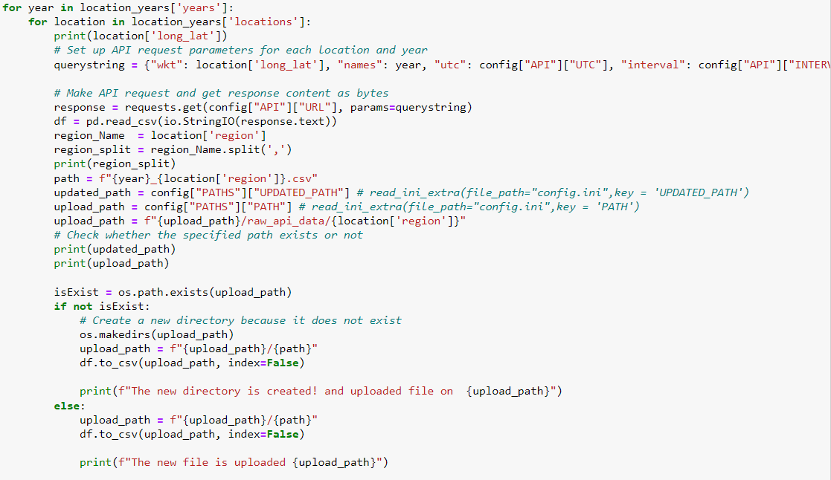
Data Collection
API URL: https://developer.nrel.gov/api/solar/nsrdb_psm3_download.csv

Slide 10
Data Collection
API URL: https://developer.nrel.gov/api/nsrdb/v2/solar/psm3-download.csv?wkt=POINT({lon}%20{lat})&names={year}&leap_day={leap}&interval={interval}&utc={utc}&full_name={name}&email={email}&affiliation={affiliation}&mailing_list={mailing_list}&reason={reason}&api_key={api}&attributes={attr}'.format(year=year, lat=lat, lon=lon, leap=leap_year, interval=interval, utc=utc, name=your_name, email=your_email, mailing_list=mailing_list, affiliation=your_affiliation, reason=reason_for_use, api=api_key, attr=attributes)

Slide 11
Model Implementation
ARIMA and Seasonal ARIMA
Autoregressive Integrated Moving Averages
The general process for ARIMA models is the following:
1. Visualize the Time Series Data
2. Make the time series data stationary
3. Plot the Correlation and Auto Correlation Charts
4. Construct the ARIMA Model or Seasonal ARIMA based on the data
5. Use the model to make predictions
Prophet Model
Hyperparameter Tuning on Prophet Model

Slide 12
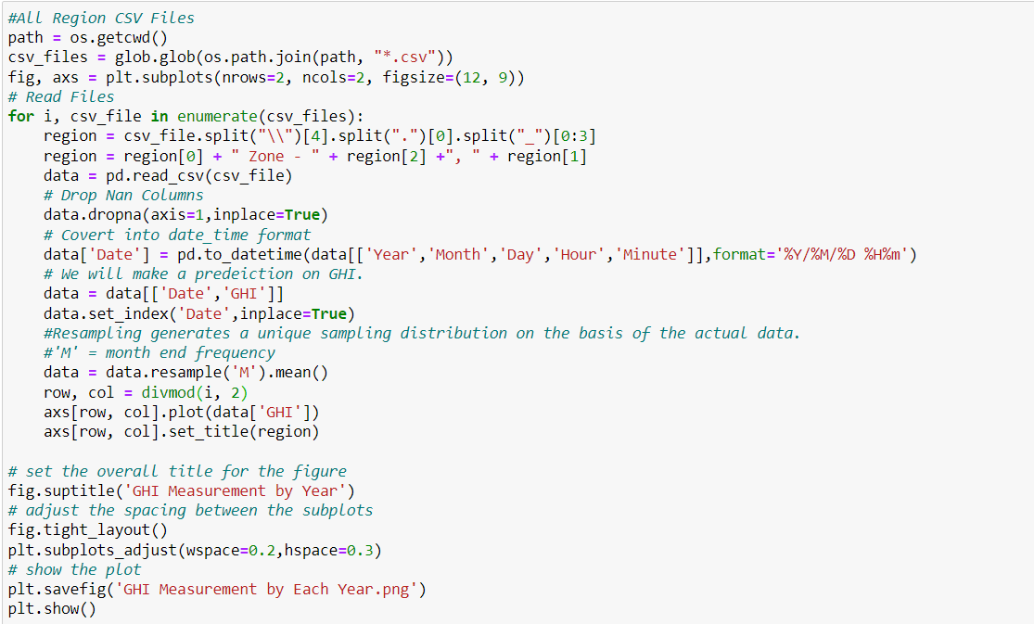
Model Implementation

Slide 13
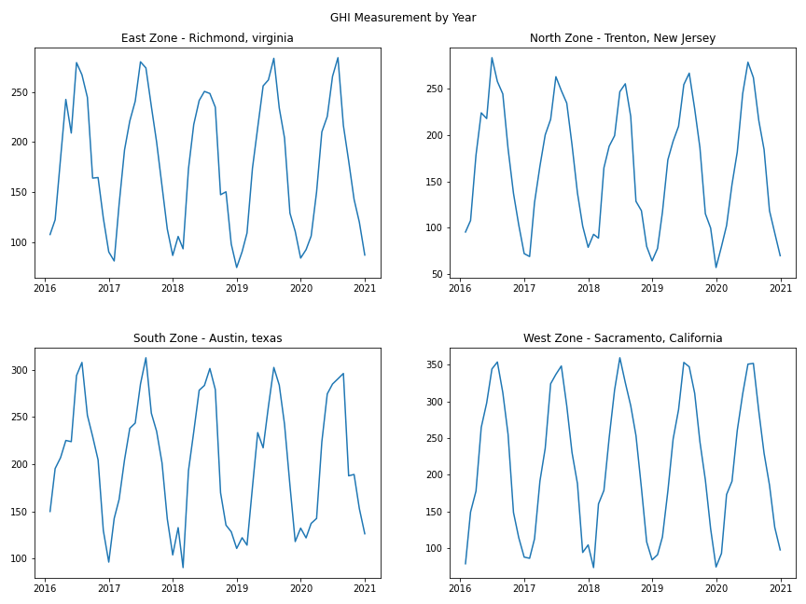
GHI by year

Slide 14
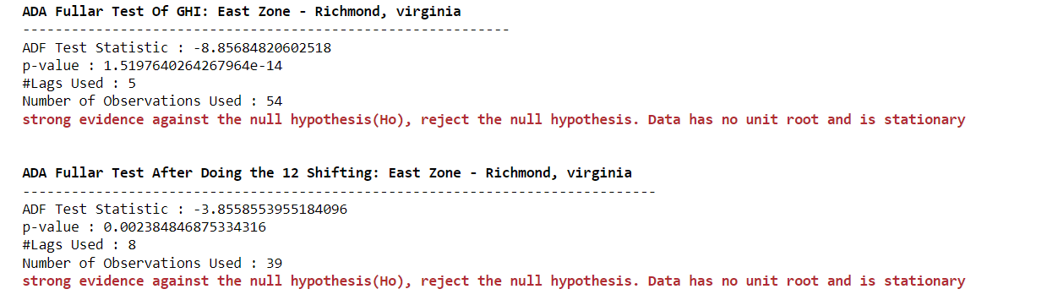
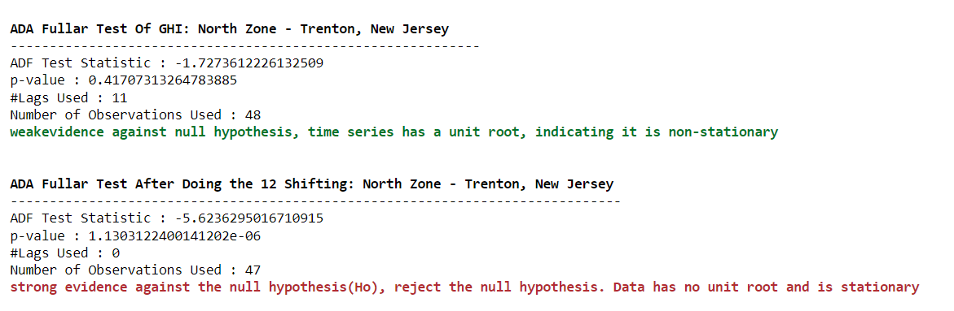
Test Result - AdaFuller

Slide 15
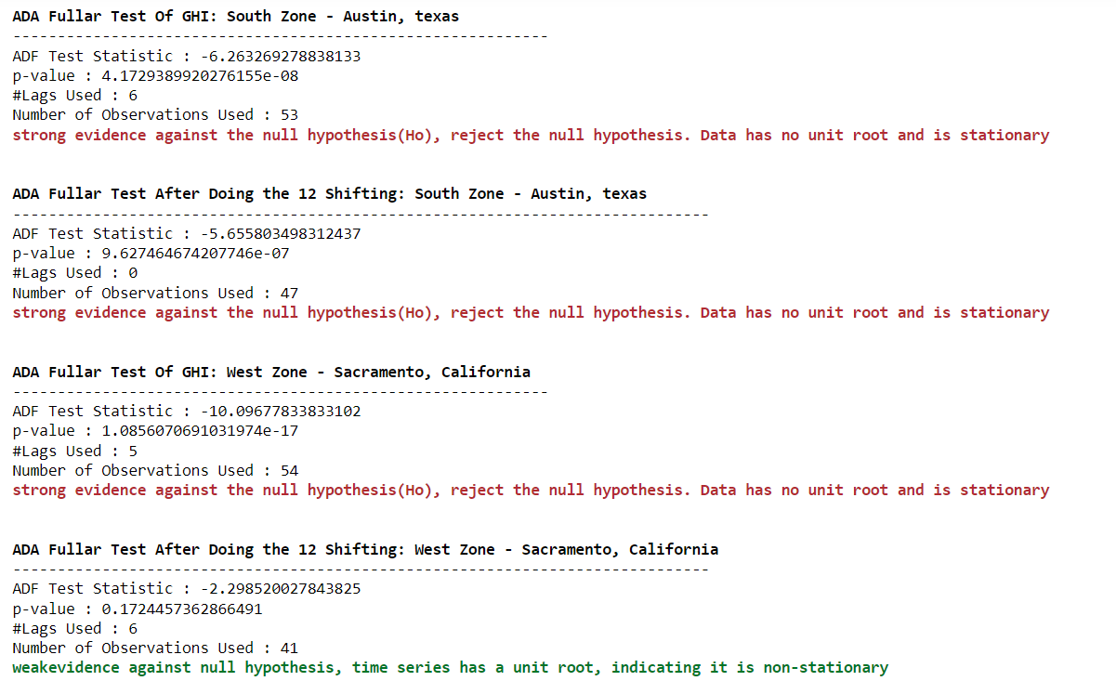
Test Result - AdaFuller

Slide 16
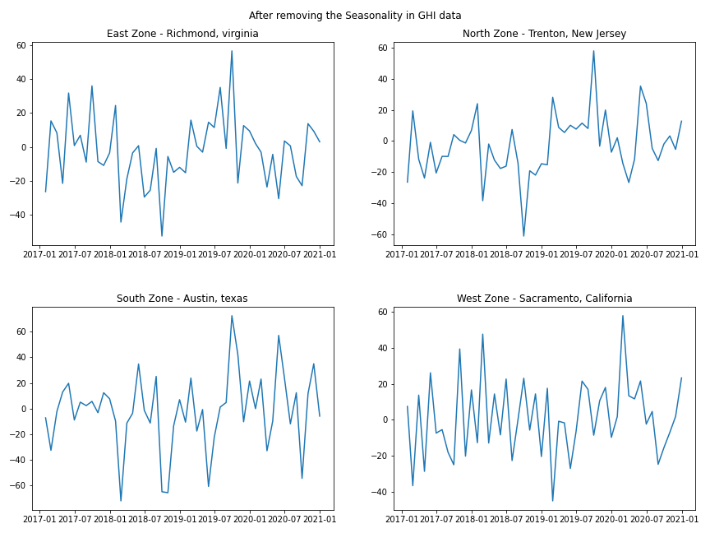
After Remove the Seasonality

Slide 17
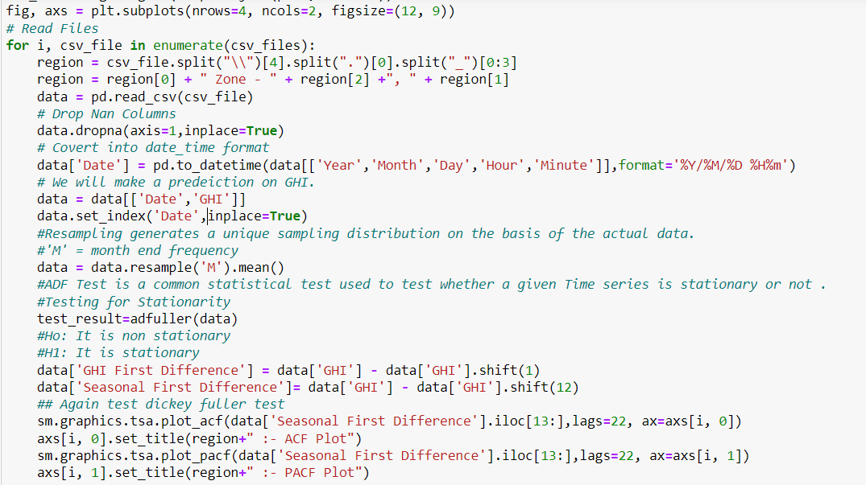
ACF & PACF Plot

Slide 18
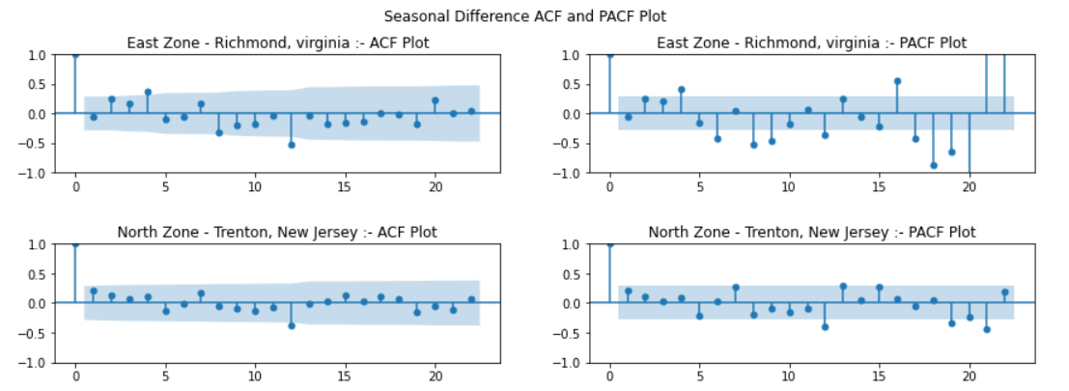
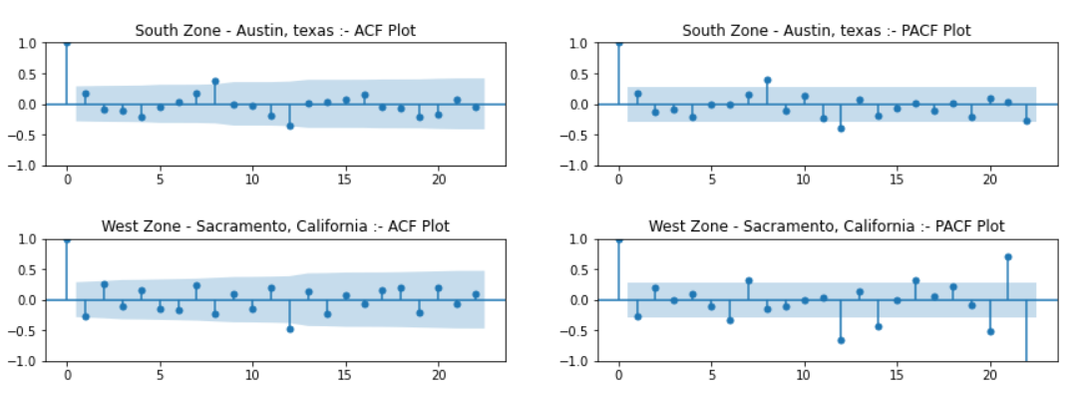
Output: ACF & PACF Plot

Slide 19
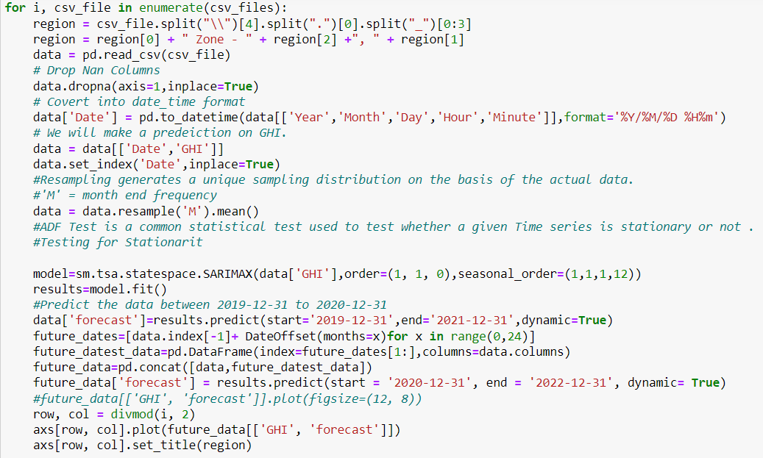
Forecasting Radiation

Slide 20
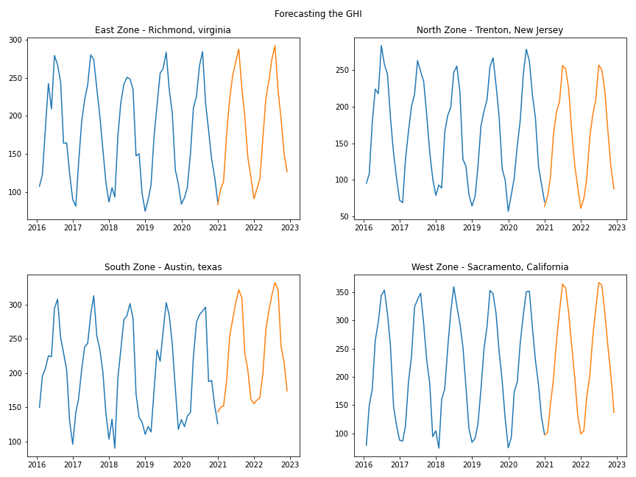
Output: Forecasting Radiation

Slide 21
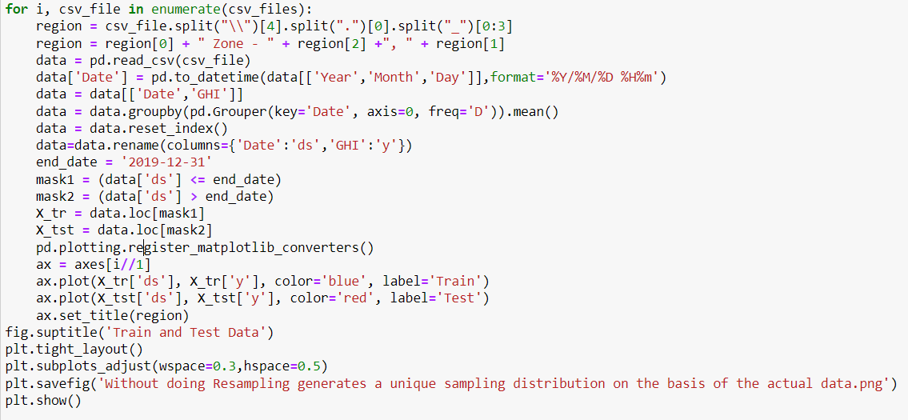
Split the data into Train and Test

Slide 22
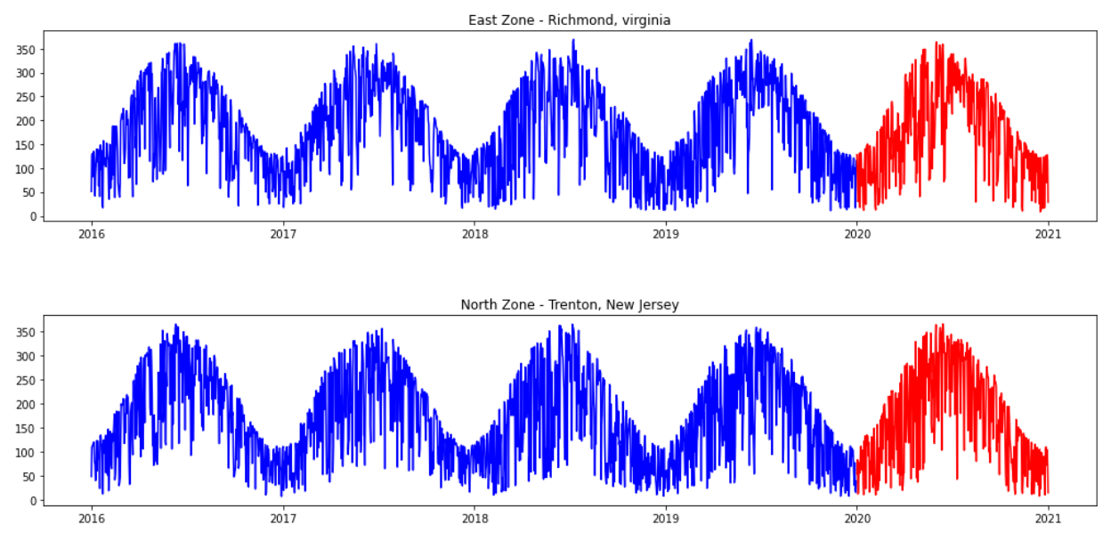
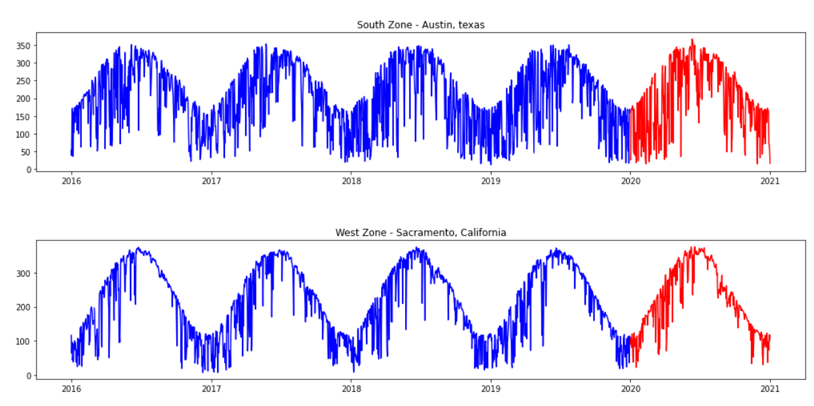
Split the data into Train and Test

Slide 23
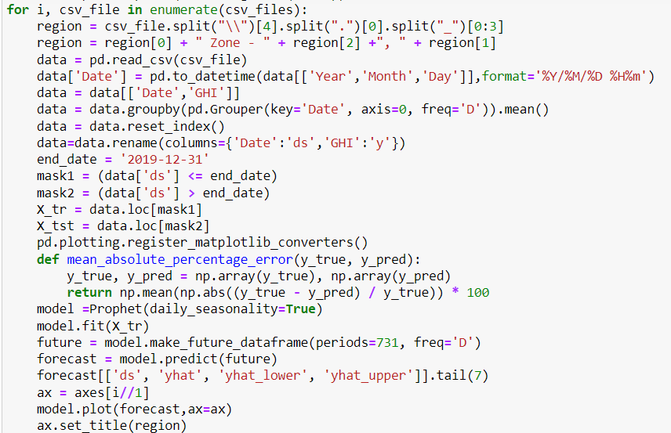
Prophet Model

Slide 24
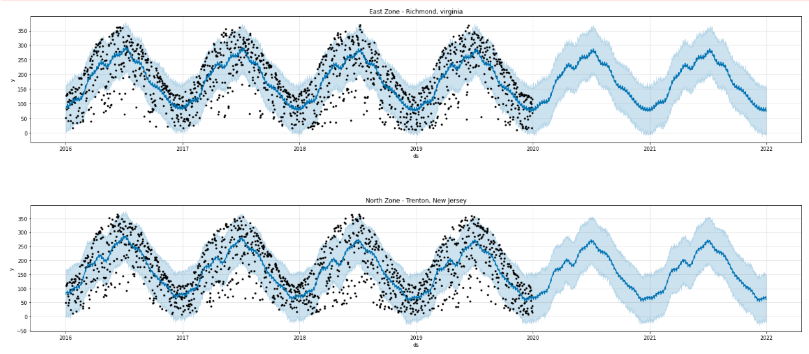
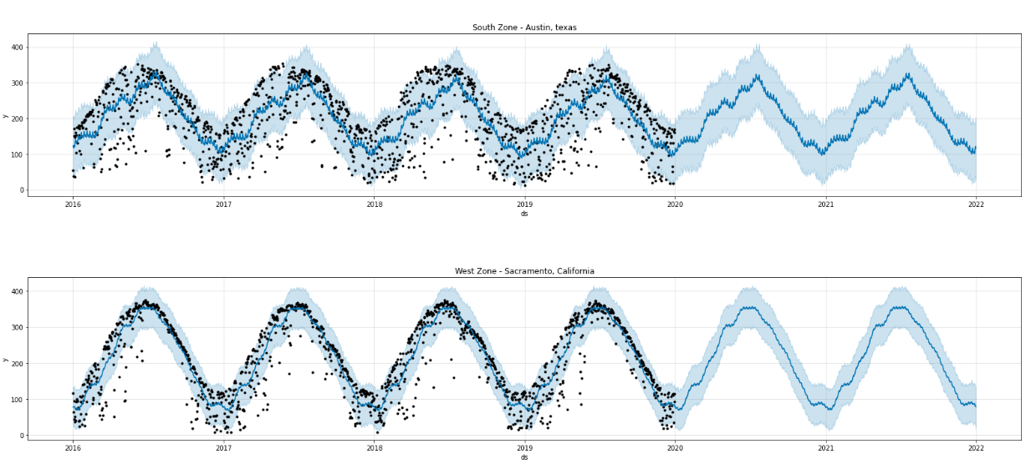
Forecasting Radiation on Train Data: Prophet Model

Slide 25
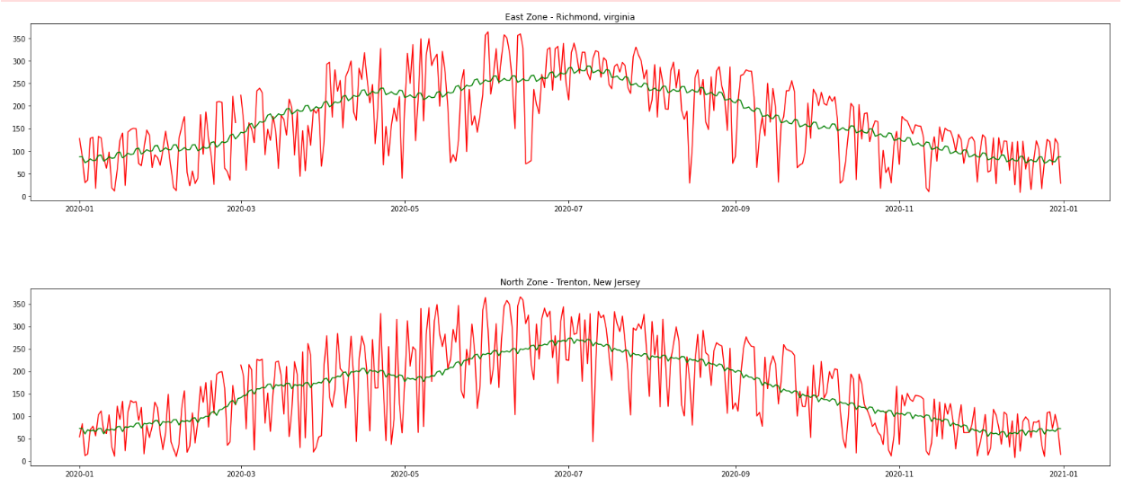
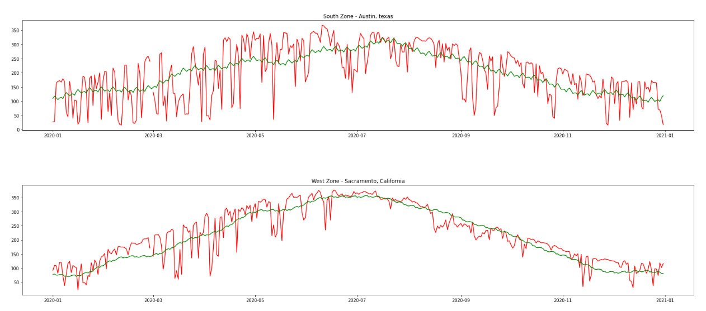
Test Data

Slide 26
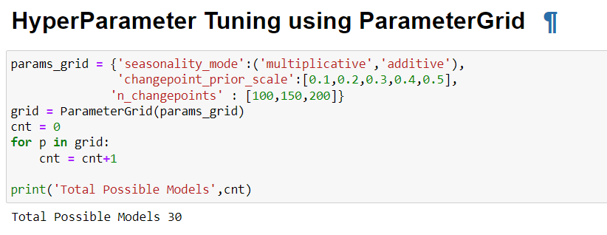
Hyper Parameter Tuning

Slide 27
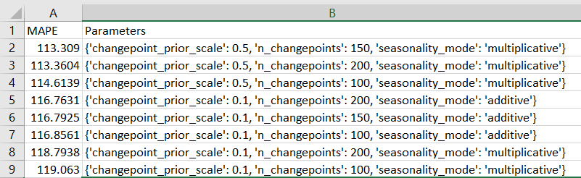
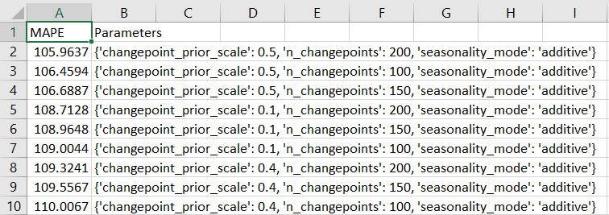
Mean Squared Error
Richmond – Virginia
Trenton – New Jersey

Slide 28
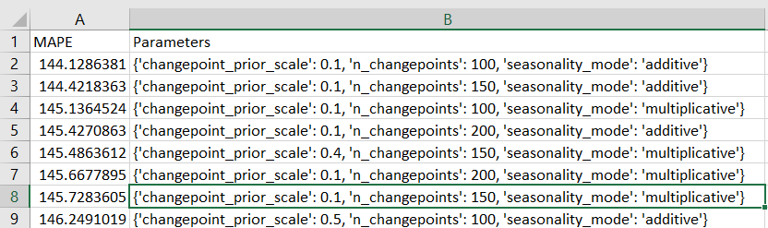
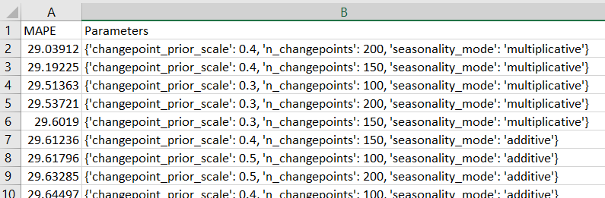
Mean Squared Error
Auston - Texas
Sacramento - California

Slide 29
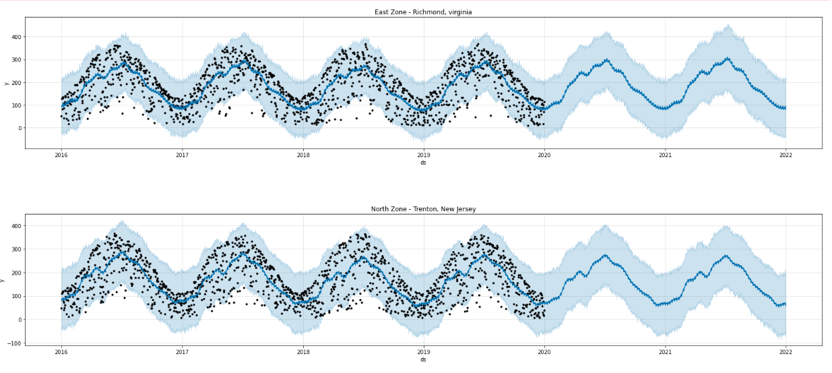
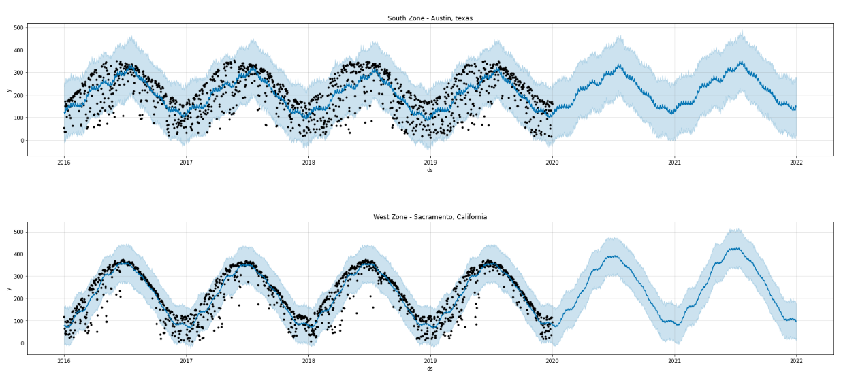
Hyper Parameter Tuning

Slide 30
Hyper tuning Results After And Before

Slide 31
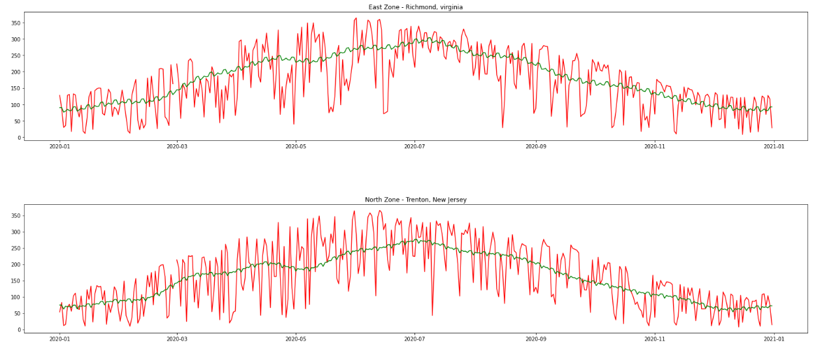
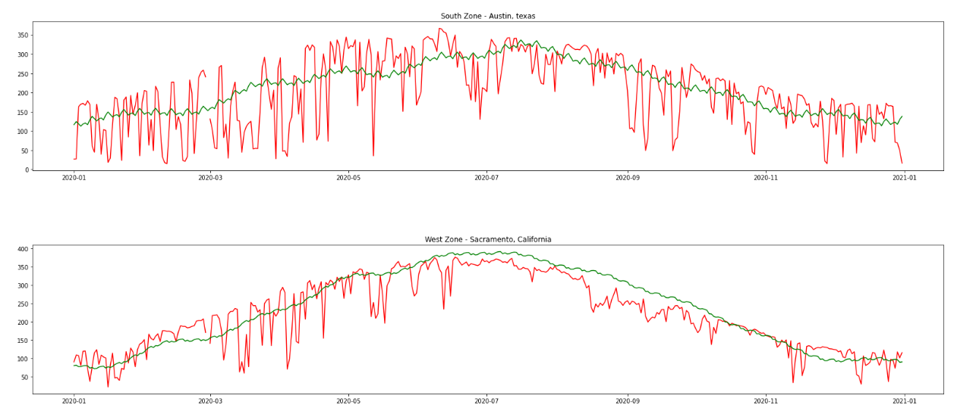
Forecasting Radiation: Test Data

Slide 32
Thank you ☺

